Slide 1
Docker Tutorial

Slide 2
What is Docker
It is an opensource containerization platform. This helps developers to package applications into container.
It encapsulate the executable components combining application source code with the libraries and dependencies required to run that code in any environment.
Founded as DotCloud in 2008 by Solomon Hykes and was running as platform as a service (PaaS). In 2013 it was introduced as open source tool with name Docker.

Slide 3
Top three containers tools
Docker
Rkt (rocket)
Microsoft Containers

Slide 4
Why Docker?
Lightweight
Portable
Greater resource efficiency

Slide 5
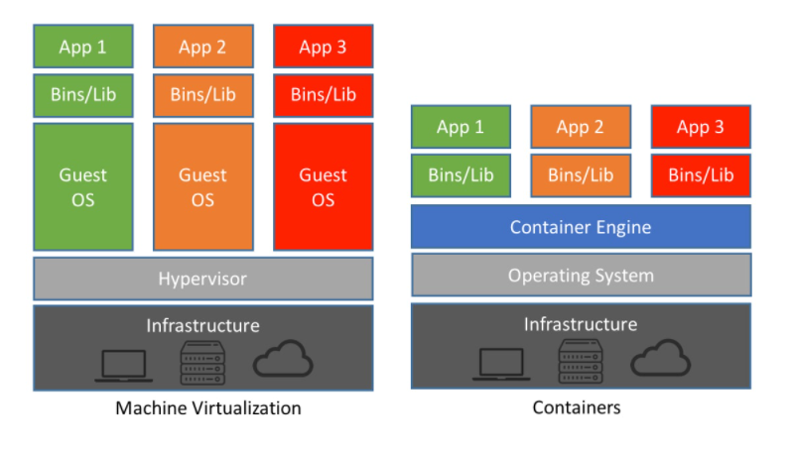
Container Vs Virtual Machine

Slide 6
Set up Docker environment
https://labs.play-with-docker.com/ (Play with Docker)
Install docker on Linux server

Slide 7
Install Docker on AWS EC2 instance
Login to AWS EC2 instance server using putty
Update all the packages
Yum update
Search for Docker package
yum search docker
Install Docker
yum install docker
Validate
Docker version

